Slide 1
Rehashing, Dynamic Hashing (Extendible hashing) using directory and without directory,

Slide 2
Rehashing
Rehashing is a collision resolution technique.
Rehashing is a technique in which the table is resized, i.e., the size of table is doubled by creating a new table. It is preferable is the total size of table is a prime number. There are situations in which the rehashing is required.
• When table is completely full
• With quadratic probing when the table is filled half.
• When insertions fail due to overflow.
In such situations, we have to transfer entries from old table to the new table by re computing their positions using hash functions

Slide 3
Example
Consider we have to insert the elements 37, 90, 55, 22, 17, 49, and 87. the table size is 10 and will use hash function:
H(key) = key mod tablesize
37 % 10 = 7
90 % 10= 0
55 % 10 = 5
22 % 10 = 2
17 % 10 = 7
49 % 10 = 9
Now this table is almost full and if we try to insert more elements collisions will occur and eventually further insertions will fail. Hence we will rehash by doubling the table size. The old table size is 10 then we should double this size for new table, that becomes 20. But 20 is not a prime number, we will prefer to make the table size as 23. And new hash function will be

Slide 4
Example
H(key) key mod 23
37 % 23 = 14
90 % 23 = 21
55 % 23 = 9
22 % 23 = 22
17 % 23 = 17
49 % 23 = 3
87 % 23 = 18
Now the hash table is sufficiently large to accommodate new insertions.

Slide 5
Dynamic hashing
The dynamic hashing method is used to overcome the problems of static hashing like bucket overflow.
In this method, data buckets grow or shrink as the records increases or decreases. This method is also known as Extensible hashing method.
This method makes hashing dynamic, i.e., it allows insertion or deletion without resulting in poor performance.
Extendible Hashing is a dynamic hashing method wherein directories, and buckets are used to hash data.
Main features of Extendible Hashing: The main features in this hashing technique are:
Directories: The directories store addresses of the buckets in pointers. An id is assigned to each directory which may change each time when Directory Expansion takes place.
Buckets: The buckets are used to hash the actual data.

Slide 6
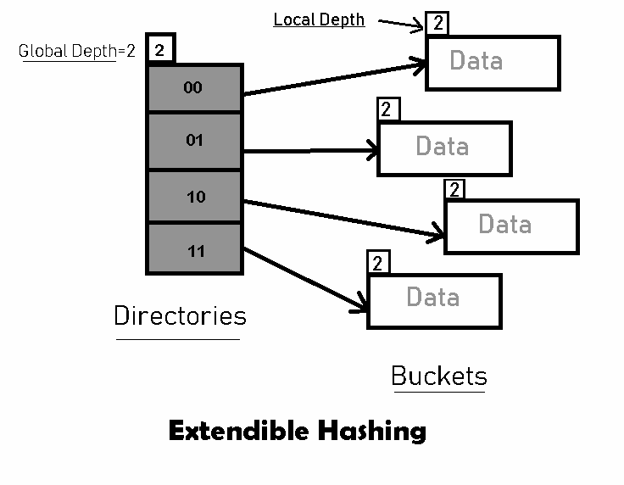
Structure of extensible hashing

Slide 7
Algorithm
Step 1 – Analyze Data Elements: Data elements may exist in various forms eg. Integer, String, Float, etc.. Currently, let us consider data elements of type integer. eg: 49.
Step 2 – Convert into binary format: Convert the data element in Binary form. For string elements, consider the ASCII equivalent integer of the starting character and then convert the integer into binary form. Since we have 49 as our data element, its binary form is 110001.
Step 3 – Check Global Depth of the directory. Suppose the global depth of the Hash-directory is 3.
Step 4 – Identify the Directory: Consider the ‘Global-Depth’ number of LSBs in the binary number and match it to the directory id. Eg. The binary obtained is: 110001 and the global-depth is 3. So, the hash function will return 3 LSBs of 110001 viz. 001.
Step 5 – Navigation: Now, navigate to the bucket pointed by the directory with directory-id 001.
Step 6 – Insertion and Overflow Check: Insert the element and check if the bucket overflows. If an overflow is encountered, go to step 7 followed by Step 8, otherwise, go to step 9.
Step 7 – Tackling Over Flow Condition during Data Insertion: Many times, while inserting data in the buckets, it might happen that the Bucket overflows. In such cases, we need to follow an appropriate procedure to avoid mishandling of data. First, Check if the local depth is less than or equal to the global depth. Then choose one of the cases below.
Case1: If the local depth of the overflowing Bucket is equal to the global depth, then Directory Expansion, as well as Bucket Split, needs to be performed. Then increment the global depth and the local depth value by 1. And, assign appropriate pointers. Directory expansion will double the number of directories present in the hash structure.
Case2: In case the local depth is less than the global depth, then only Bucket Split takes place. Then increment only the local depth value by 1. And, assign appropriate pointers.

Slide 8
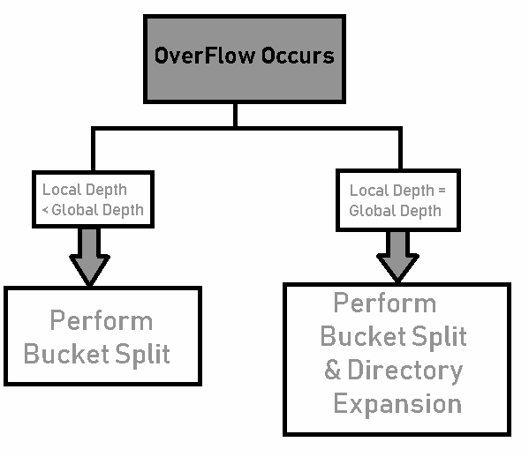
Algorithm
Step 8 – Rehashing of Split Bucket Elements: The Elements present in the overflowing bucket that is split are rehashed w.r.t the new global depth of the directory.
Step 9 – The element is successfully hashed.

Slide 9
Example
Example based on Extendible Hashing: Now, let us consider a prominent example of hashing the following elements: 16,4,6,22,24,10,31,7,9,20,26.
Bucket Size: 3 (Assume)
Hash Function: Suppose the global depth is X. Then the Hash Function returns X LSBs.
Solution: First, calculate the binary forms of each of the given numbers. 16- 10000 4- 00100 6- 00110 22- 10110 24- 11000 10- 01010 31- 11111 7- 00111 9- 01001 20- 10100 26- 11010
Initially, the global-depth and local-depth is always 1. Thus, the hashing frame looks like this:

Slide 10
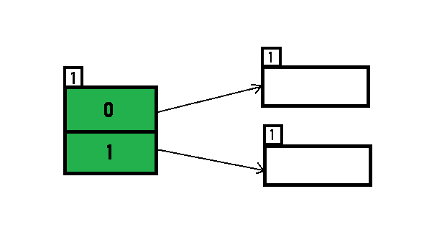
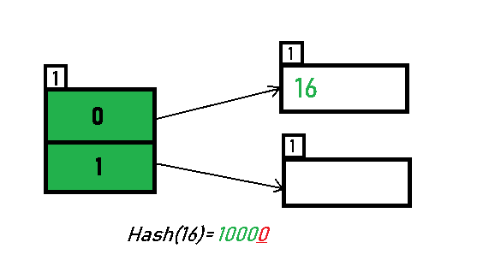
Inserting 16:
The binary format of 16 is 10000 and global-depth is 1. The hash function returns 1 LSB of 10000 which is 0. Hence, 16 is mapped to the directory with id=0.

Slide 11
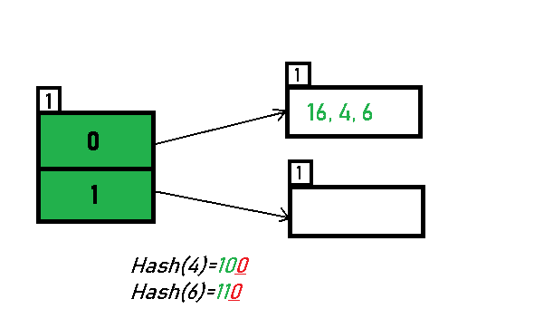
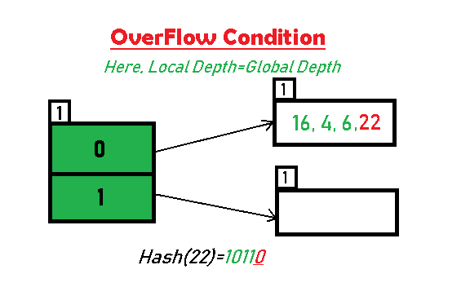
Example
Inserting 4 and 6:
Both 4(100) and 6(110)have 0 in their LSB. Hence, they are hashed as follows:
Inserting 22: The binary form of 22 is 10110. Its LSB is 0. The bucket pointed by directory 0 is already full. Hence, Over Flow occurs.

Slide 12
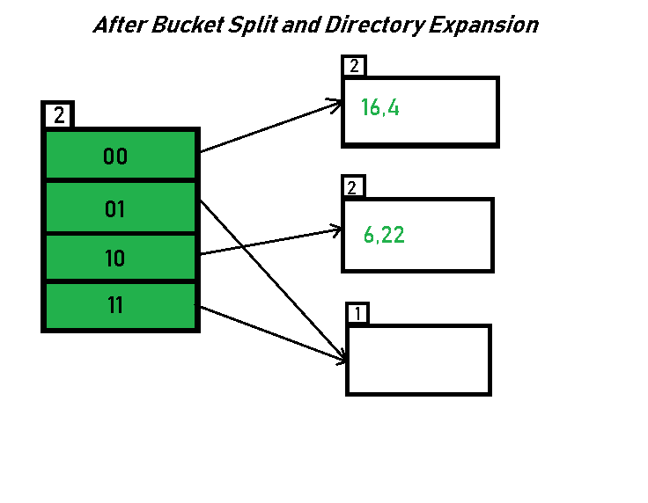
As directed by Step 7-Case 1, Since Local Depth = Global Depth, the bucket splits and directory expansion takes place. Also, rehashing of numbers present in the overflowing bucket takes place after the split. And, since the global depth is incremented by 1, now,the global depth is 2. Hence, 16,4,6,22 are now rehashed w.r.t 2 LSBs.[ 16(10000),4(100),6(110),22(10110) ]

Slide 13
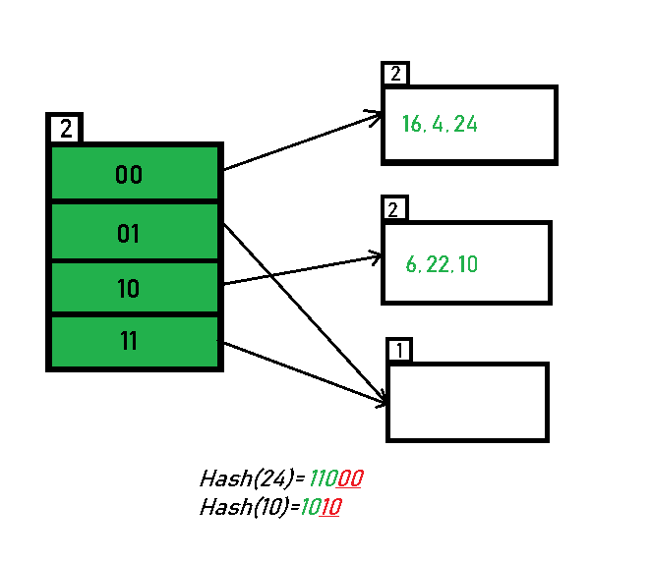
Inserting 24 and 10: 24(11000) and 10 (1010) can be hashed based on directories with id 00 and 10. Here, we encounter no overflow condition.

Slide 14
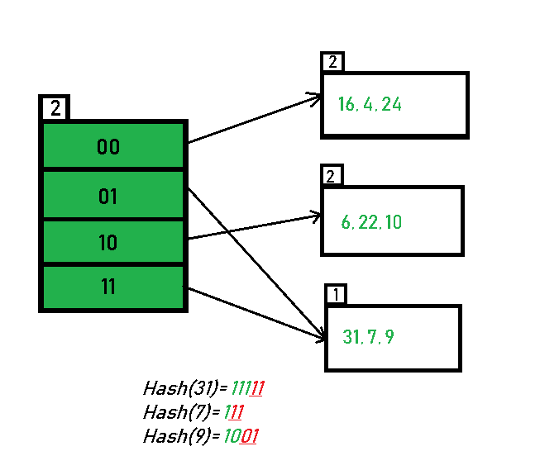
Inserting 31,7,9: All of these elements[ 31(11111), 7(111), 9(1001) ] have either 01 or 11 in their LSBs. Hence, they are mapped on the bucket pointed out by 01 and 11. We do not encounter any overflow condition here.

Slide 15
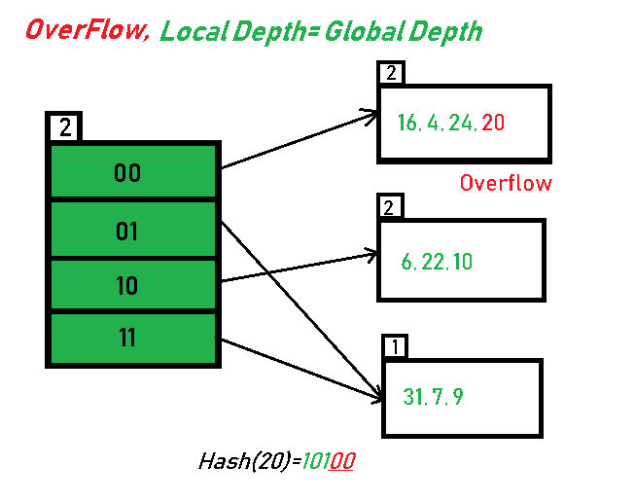
Inserting 20: Insertion of data element 20 (10100) will again cause the overflow problem.
20 is inserted in bucket pointed out by 00. As directed by Step 7-Case 1, since the local depth of the bucket = global-depth, directory expansion (doubling) takes place along with bucket splitting. Elements present in overflowing bucket are rehashed with the new global depth. Now, the new Hash table looks like this:

Slide 16
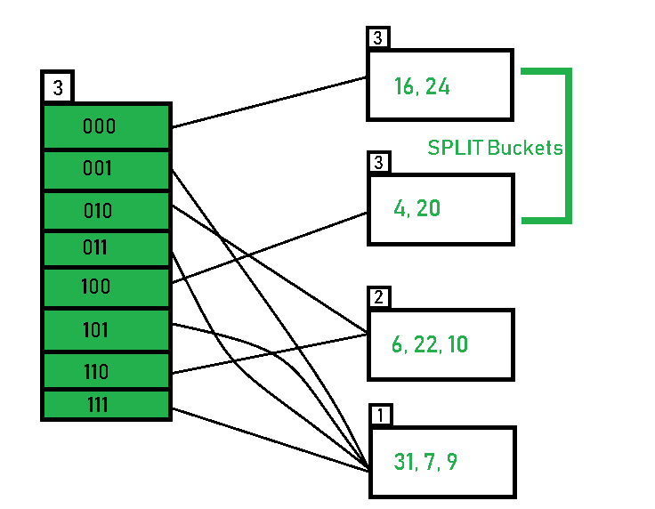

Slide 17
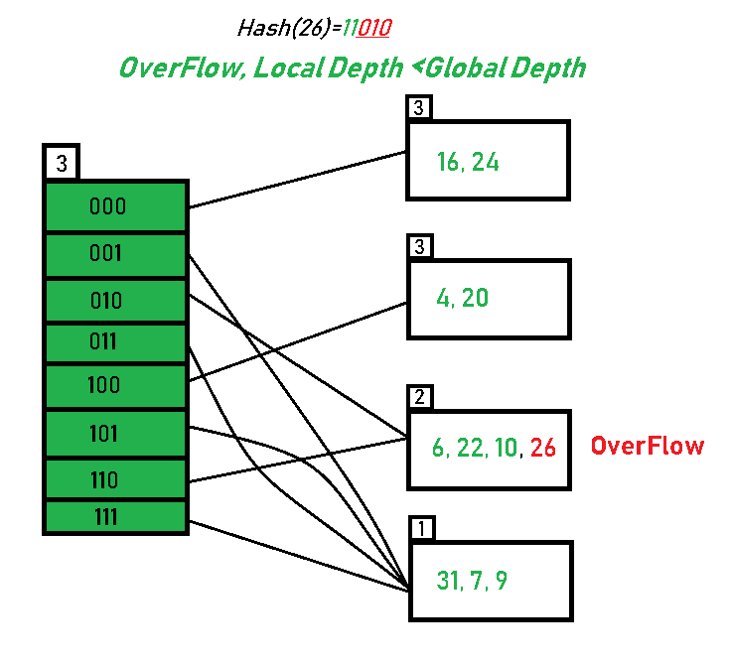
Inserting 26: Global depth is 3. Hence, 3 LSBs of 26(11010) are considered. Therefore 26 best fits in the bucket pointed out by directory 010.

Slide 18
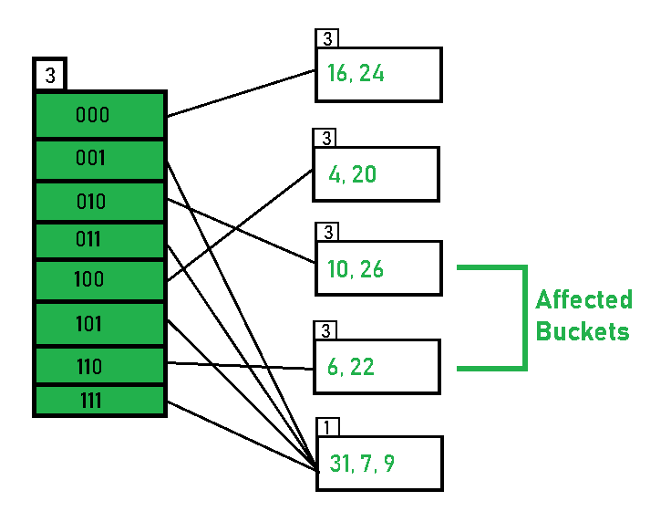
The bucket overflows, and, as directed by Step 7-Case 2, since the local depth of bucket < Global depth (2<3), directories are not doubled but, only the bucket is split and elements are rehashed.
Finally, the output of hashing the given list of numbers is obtained.

Slide 19
Advantages and Disadvantages
Advantages:
Data retrieval is less expensive (in terms of computing).
No problem of Data-loss since the storage capacity increases dynamically.
With dynamic changes in hashing function, associated old values are rehashed w.r.t the new hash function.
Limitations Of Extendible Hashing:
The directory size may increase significantly if several records are hashed on the same directory while keeping the record distribution non-uniform.
Size of every bucket is fixed.
Memory is wasted in pointers when the global depth and local depth difference becomes drastic.
This method is complicated to code.

Slide 20
Difference Between Static and Dynamic Hashing
Key Factor | Static Hashing | Dynamic Hashing
Form of Data | Fixed-size, non-changing data. | Variable-size, changing data.
Result | The resulting Data Bucket is of fixed-length. | The resulting Data Bucket is of variable-length.
Bucket Overflow | Challenge of Bucket overflow can arise often depending upon memory size. | Bucket overflow can occur very late or doesn’t occur at all.
Complexity | Simple | Complex

